Slide 1
Portfolio Sentinel
Team

Slide 2
Team Member information
Chandler Rathke
Dennis Vo
Mason Leffel
Antone Thygerson
Edgar Arvizu

Slide 3

Client info
Accutech
Main : Matt Garrett
Mentor: Drew Heiss

Slide 4
Business requirements
BR1 - Generative AI with Prompts
A generative AI is required to summarize and generate information based on a client's financial needs.
BR2 - Advisor and Client
Advisor and client details will be required in order to manage who receives the emails and where the documentation will be coming from.

Slide 5
Use Cases
Monitoring portfolio changes is a key function of the system. Clients need to be informed about the status of their investments and any changes that may impact their portfolio. On a quarterly basis, the system will check for any changes, retrieve relevant information, and email the advisor. This enables the advisor to inform the client and make the appropriate decisions.
One of our requirements was to allow advisors to manage their clients and have access to their clients’ portfolio details to make informed investment decisions. This allows advisors to retrieve necessary information and data to help them stay updated and effectively manage their clients' portfolios.

Slide 6
Requirements
FR1: Advisor management - retrieve advisor information high - create new advisor medium - delete advisor medium - list of clients linked to advisor high
UC2
FR2: Client management - retrieve client information and link to portfolio high - create new clients medium - delete clients medium
UC1
NR1: Performance - retrieve advisor and client information from database with no delay
High
UC2
NR2: Scalability - system should be able to handle a growing number of advisors and clients and documents
Medium
UC2
NR3: Secuirty - advisor and client information to be stored and transferred securely
High
UC2

Slide 7
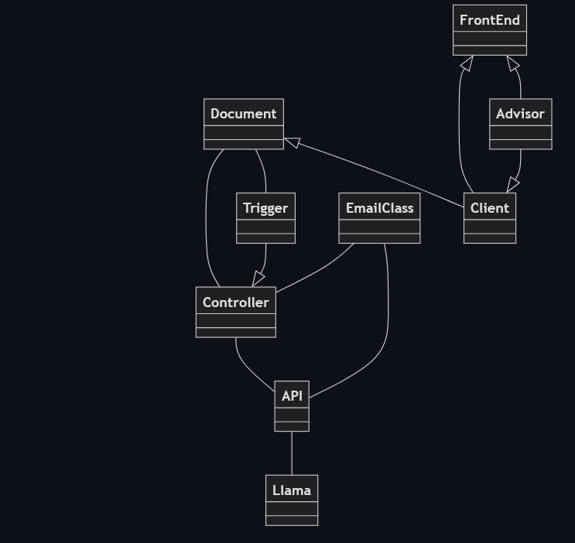
Domain model
AdvisorInformation
Retrieves the advisor information and matches it to their clients
ClientInformation
Retrieves the client information and matches it to their portfolio
Controller
Processes requests between all the other aspects of the domain
API
Processes requests between the Controller and the Llama AI
FrontEnd
An admin terminal to help test the API
Notes:
EmailClass
Summarizes the information from the AI prompt and then sends it as an email
Trigger
Checks if new quarterly statements are out
Llama
Generative AI tool
Document
Collection of portfolio related assets that pertain to the client
Stock
Financial Asset
Mutual Fund
Collection of stocks/ bonds

Slide 8
TechStack
Vue
Vue JavaScript
This is a JavaScript open-source front-end framework with a large community and comprehensible documentation. Other projects from Accutech use Vue, so building in a familiar framework for them will allow them to build off of the project after we have finished our work.
.Net and C#
C# Documentation
.Net and C# are going to be used for the back-end code. Both are popular frameworks with developers and have a number of sources and libraries that can be learned from. Accutech has used these for previous projects, therefore, using these will benefit them long after we are finished.
Llam
A collection of pretrained generative models. This was the AI model recommended by our mentor for the use as our generative AI.

Slide 9
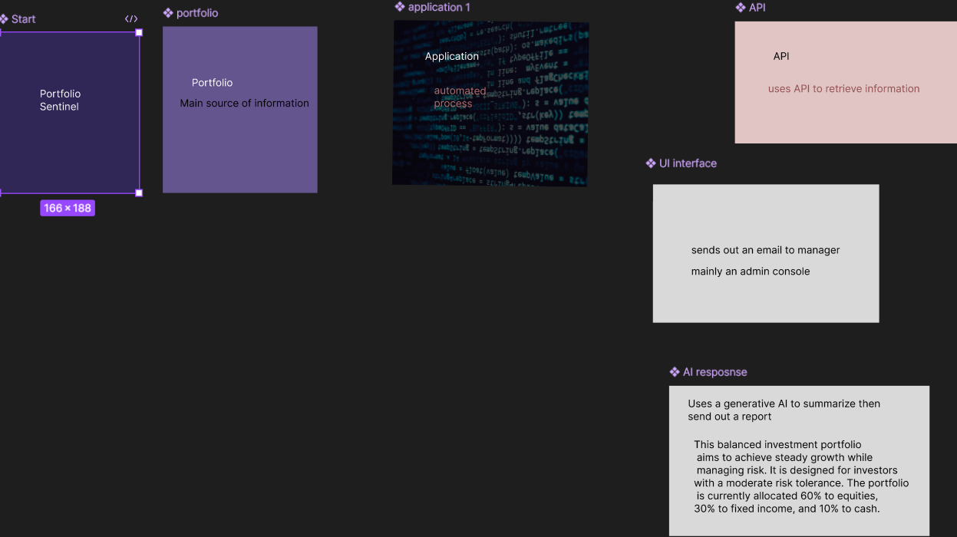
Prototype

Slide 10
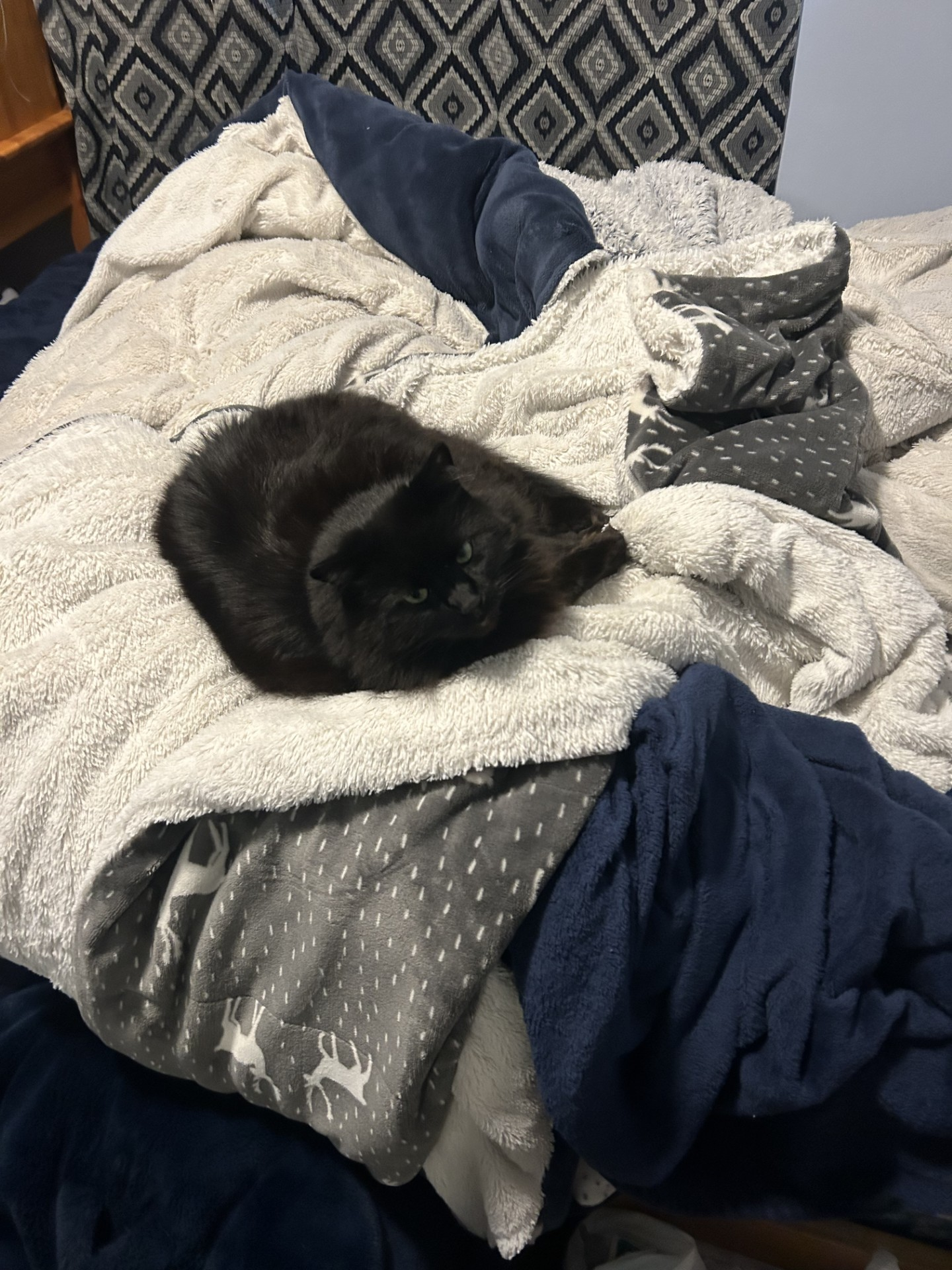
Fun slide

